Slide 1
PyTorch Tutorial
Zhuangwei Zhuang
Southern Artificial Intelligence Laboratory
South China University of Technology
July 25, 2017

Slide 2
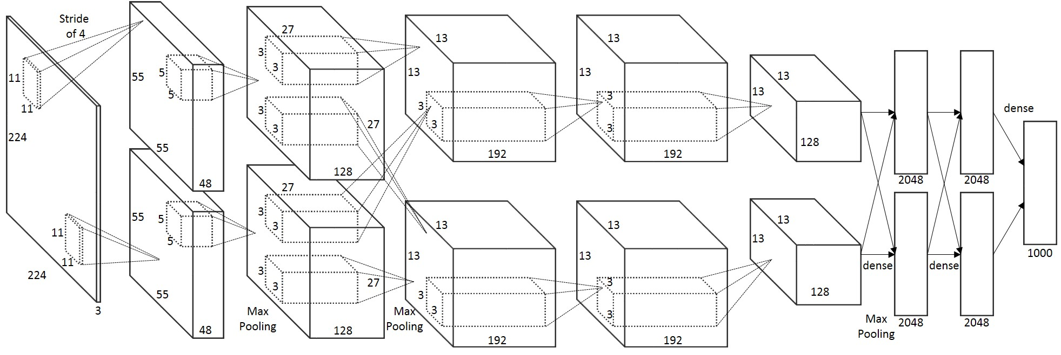
Background
Deep learning have achieved great performance on image classification, object detection and speech recognition
Architecture of AlexNet

Slide 3
Platforms for Deep Learning
PyTorch
Torch
Deep Learning
Caffe
Tensor Flow
MXNet
Theano

Slide 4
Outline
Introduction
Deep learning in PyTorch

Slide 5
Introduction

Slide 6

What is PyTorch
PyTorch is a python package for tensor computation and deep neural networks (DNNs). One can use PyTorch as:
A replacement for Numpy to use power of GPU
A deep learning platform with maximum fexibility and speed

Slide 7
Official Websites
Get help from the following websites:
Source codes: https://github.com/pytorch/pytorch
Official website: http://pytorch.org/
Official tutorials: http://pytorch.org/tutorials/
Official documents: (Provide detail description of all packages): http://pytorch.org/docs/
PyTorch forums: (Platform for discussion) https://discuss.pytorch.org/
PyTorch examples: https://github.com/pytorch/examples

Slide 8
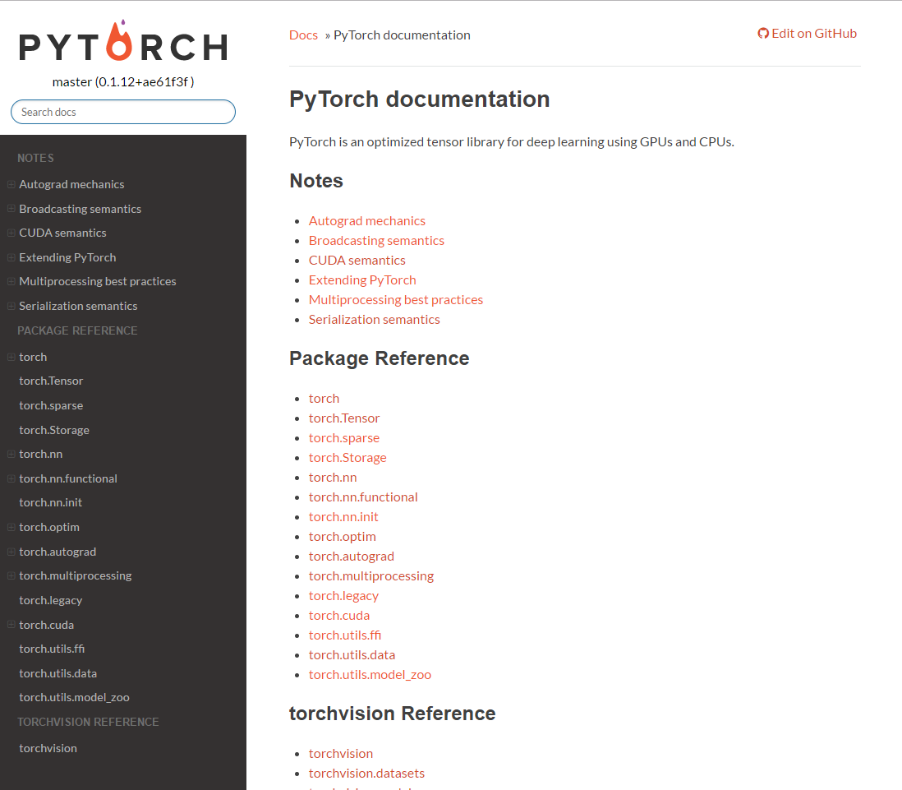
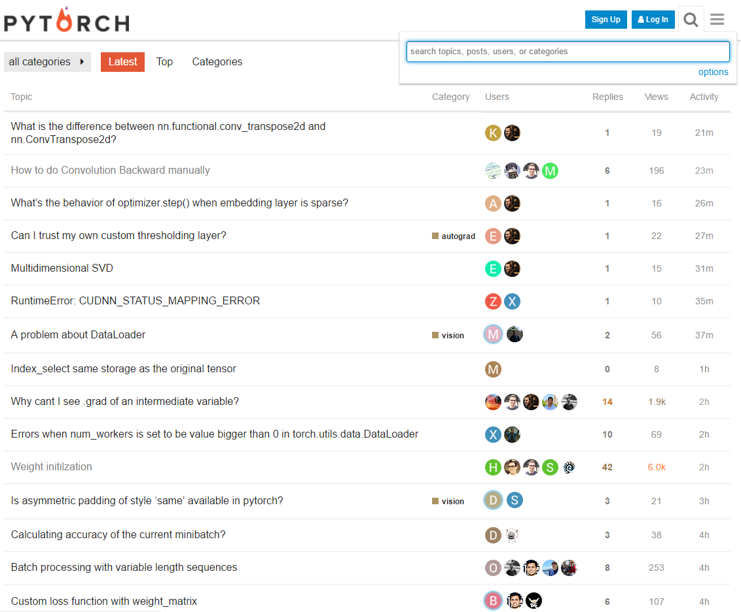
Official Websites
PyTorch documentation
PyTorch forum

Slide 9
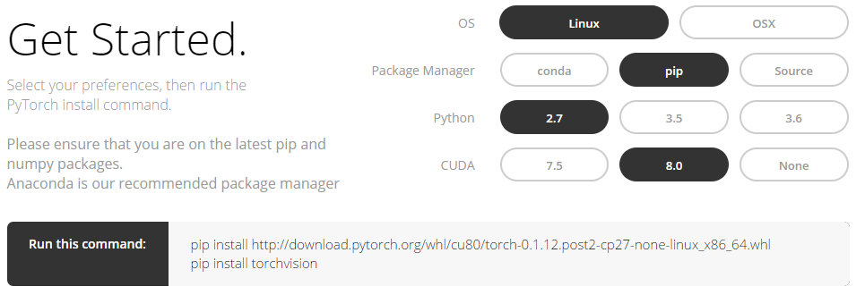
Installation
PyTorch only supports Linux and OSX. One can install PyTorch with following methods:
Binaries(recommended)
From source
Docker image

Slide 10
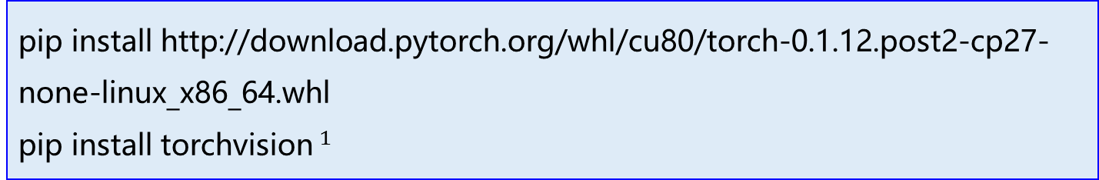
Installation
Install PyTorch from binaries:
Settings: Linux, Python-2.7, Cuda-8.0
Run the following commands on shell:
pip install http://download.pytorch.org/whl/cu80/torch-0.1.12.post2-cp27-none-linux_x86_64.whl
pip install torchvision$^{1}$
$^{1}$torchvision is a package that contains deep learning models and data sets for computer vision tasks.

Slide 11
PyTorch Packages
PyTorch consists of the following components:
torch: a tensor library with strong GPU support
torch.autograd: a automatic dierentiation library
torch.nn: a neural networks library
torch.multiprocessing: a python multiprocessing library with memory sharing of Tensors across processes.
torch.utils: including utility functions.
torch.legacy: legacy code ported over from Torch

Slide 12
Use PyTorch for Computation

Slide 13
Data Type
Tensor: an n-dimensional array like numpy array
Variable: used for automatic differentiation. Almost all operations of Tensor can be performed on Variable
Variable
Tensor
data
grad
data
creator

Slide 14
Tensor
PyTorch defines seven CPU tensor types and eight GPU tensor types
Data type | CPU tensor | GPU tensor
16-bit floating point | - | torch.cuda.HalfTensor
32-bit floating point | torch.FloatTensor | torch.cuda.FloatTensor
64-bit floating point | torch.DoubleTensor | torch.cuda.DoubleTensor
8-bit integer (unsigned) | torch.ByteTensor | torch.cuda.ByteTensor
8-bit integer (signed) | torch.CharTensor | torch.cuda.CharTensor
16-bit integer (signed) | torch.ShortTensor | torch.cuda.ShortTensor
32-bit integer (signed) | torch.IntTensor | torch.cuda.IntTensor
64-bit integer (signed) | torch.LongTensor | torch.cuda.LongTensor
*
=

Slide 15
Tensor
A tensor can be constructed through two methods:
From Python list or sequence
By specifying tensor size
>>>import torch >>>torch.FloatTensor([[1, 2, 3], [1, 2, 3]]) 1 2 3 1 2 3 [torch.FloatTensor of size 2x3] >>>torch.FloatTensor(2, 4).fill_(1) 1 1 1 1 1 1 1 1 [torch.FloatTensor of size 2x4]

Slide 16
Creation Operations
torch.eye(n, m=None, out=None)
torch.from_numpy(ndarray)
torch.linspace(start, end, steps=100, out=None)
torch.logspace(start, end, steps=100, out=None)
torch.ones(*sizes, out=None)
torch.rand(*sizes, out=None)
torch.randn(*sizes, out=None)
torch.randperm(n, out=None)
torch.arange(start, end, step=1, out=None)
torch.range(start, end, step=1, out=None)
torch.zeros(*sizes, out=None)

Slide 17
Creation Operations
torch.zeros(*sizes, out=None)
returns a tensor filled with the scalar value 0, with the shape defined by the varargs sizes
>>>import torch >>>torch.zeros(4, 5) 0 0 0 0 0 0 0 0 0 0 0 0 0 0 0 0 0 0 0 0 [torch.FloatTensor of size 4x5]

Slide 18
Indexing, Slicing, Joining and Mutating
torch.cat(seq, dim=0, out=None)
torch.chunck(tensor, chunks, dim=0)
torch.gather(input, dim, index, out=None)
torch.index_select(input, dim, index, out=None)
torch.masked_select(input, mask, out=None)
torch.nonezero(input, out=None)
torch.split(tensor, split_size, dim=0)
torch.squeeze(input, dim=None, out=None)
torch.stack(sequence, dim=0, out=None)
torch.t(input, out=None)
torch.transpose(input, dim0, dim1, out=None)
torch.unbind(tensor, dim=0)
torch.unsqueeze(input, dim, out=None)

Slide 19
Indexing, Slicing, Joining and Mutating
torch.squeeze(input, dim=None, out=None)
returns a tensor with all the dimentions of input of size 1 removed
>>>import torch >>>x = torch.zeros(2, 1, 2, 1, 2) >>>x.size() (2L, 1L, 2L, 1L, 2L) >>> >>>y = torch.squeeze(x) >>>y.size() (2L, 2L, 2L) >>> >>>y = torch.squeeze(x, 0) >>>y.size() (2L, 1L, 2L, 1L, 2L)

Slide 20
Math Operations
PyTorch provides many math functions:
Pointwise Operations
add(), ceil(), clamp(), div(), cos(), abs(), …
Reduction Operations
dist(), mean(), std(), norm(), sum(), var(), …
Comparison Operations
eq(), equal(), ge(), max(), ne(), sorted(), …
Other Operations
diag(), trace(), cross(), …
BLAS and LAPACK Operations
addbmm(), admm(), addmv(), …

Slide 21

Pointwise Operations
torch.add(input, value, out=None)
Adds the scalar value to each element of the input tensor and returns a new resulting tensor
$$out=tensor+value$$
>>> import torch >>> a = torch.FloatTensor(2).fill_(1) >>> a 1 1 [torch.FloatTensor of size 4] >>> >>> torch.add(a, 20) 21 21 [torch.FloatTensor of size 4]

Slide 22
Pointwise Operations
torch.clamp(input, min, max, out=None)
Clamp all elements in input into the range [min, max] and return a resulting tensor
>>> import torch >>> a = torch.randn(1, 4) >>> a 1.3869 0.3912 -0.8634 -0.5468 [torch.FloatTensor of size 1x4] >>> >>> torch.clamp(a, min=-0.5, max=0.5) 0.5000 0.3912 -0.5000 -0.5000 [torch.FloatTensor of size 4]

Slide 23
Reduction Operations
torch.dist(input, other, p)
Returns the p-norm of (input-output)
>>> import torch >>> x = torch.randn(1, 4) >>> x -1.6409 1.3947 0.6996 1.0198 [torch.FloatTensor of size 1x4] >>>y = torch.randn(1, 4) >>>y -0.5953 0.9713 0.3326 0.5763 [torch.FloatTensor of size 1x4] >>> torch.dist(x, y) 1.266429174687561

Slide 24
Reduction Operations
torch.mean(input)
Returns the mean value of all elements in the input tensor
>>> import torch >>> x = torch.randn(1, 3) >>> x -0.2946 -0.9143 2.1809 [torch.FloatTensor of size 1x3] >>>torch.mean(x) 0.32398951053619385

Slide 25
Comparison Operations
torch.eq(input, other, out=None)
Computes element-wise equality and returns a torch.ByteTensor containing a 1 at each location where the tensors are equal and a 0 at every other location
>>> x = torch.Tensor([[1, 2], [3, 4]]) 1 2 3 4 [torch.FloatTensor of size 2x2] >>>x.eq(2) 0 1 0 0 [torch.ByteTensor of size 2x2]

Slide 26
Comparison Operations
torch.max(input)
Returns the maximum value of all elements in the input tensor
>>> x = torch.Tensor([[1, 2], [3, 4]]) 1 2 3 4 [torch.FloatTensor of size 2x2] >>>x.max() 4

Slide 27
Other Operations
torch.diag(input, diagonal=0, out=None)
If input is a vector, then returns a 2D tensor with the elements of input as the diagonal
If input is a matrix, then returns a 1D tensor with the diagonal elements of input
>>> x = torch.Tensor([1, 2, 3]) >>> torch.diag(x) 1 0 0 0 2 0 0 0 3 [torch.FloatTensor of size 3x3]

Slide 28
BLAS and LAPACK Operations
torch.addmm(beta=1, mat, alpha=1, mat1, mat2, out=None)
Performs a matrix multiplication of the matrices mat1 and mat2. The matrix mat is added to the final result.
>>> M = torch.randn(2, 3) >>>mat1 = torch.randn(2, 3) >>>mat2 = torch.randn(3, 3) >>>torch.addmm(M, mat1, mat2) -0.4095 -1.9703 1.3561 5.7674 -4.9760 2.7378 [torch.FloatTensor of size 3x3]

Slide 29
Variable
class torch.autograd.Variable
data (any tensor class): tensor to wrap
requires_grad(bool): indicating whether the Variable has been created by a subgraph containing any Variable. Can be changed only on leaf Variables
volatile(bool): indicating whether the Variable should be used in inference mode
>>>import torch >>>from torch.autograd import Variable >>>x = Variable(torch.randn(3, 3), volatile=False)

Slide 30
Variable
Variable API is nearly the same as regular Tensor API. In most cases tensors can be safely replaced with Variables
data: tensor
grad: gradient
creator: function that create the variable
w
h
mul
>>>import torch >>>from torch.autograd import Variable >>> >>>w = Variable(torch.randn(3, 3)) >>>h = Variable(torch.randn(3, 3)) >>>x = w*h >>> >>>y = Variable(torch.randn(3, 3)) >>>z = x+y
x
y
add
z

Slide 31
Variable
backward(gradient=None, retain_graph=None, create_graph=None, retain_variables=None)
computes the gradient of current variable w.r.t graph leaves
detach()
returns a new Variable, detached from the current graph
detach_()
detaches the Variable from the graph that created it
register_hook(hook)
registers a backward hook
reinforce(reward)
registers a reward obtained as a result of a stochastic process

Slide 32
Variable
register_hook(hook)
Registers a backward hook. The hook will be called every time a gradient w.r.t the Variable is computed.
>>>import torch >>>from torch.autograd import Variable >>>v = Variable(torch.Tensor([0, 0, 0]), requires_grad=True) >>> >>>h = v.register_hook(lambda grad: grad * 2) # double the gradient >>> >>>v.backward(torch.Tensor([1, 1, 1])) >>> >>>v.grad.data 2 2 2 [torch.FloatTensor of size 3] >>> >>>h.remove() # removes the hook

Slide 33
GPU Supported
All operations can be conducted on GPU if the tensor is converted to cuda.tensor
>>>import torch >>>x = torch.randn(3, 3) >>>x 1.1980 -1.2213 0.5500 0.0943 -0.0436 -1.9253 0.6731 0.4803 -1.5076 [torch.FloatTensor of size 3x3] >>>x.cuda() 1.1980 -1.2213 0.5500 0.0943 -0.0436 -1.9253 0.6731 0.4803 -1.5076 [torch.cuda.FloatTensor of size 3x3 (GPU 0)]

Slide 34
Deep Learning In PyTorch

Slide 35
Experiment Pipeline
Prepare data sets
Important concepts:
Data loader:
loading and preprocessing data
Optimizer:
including SGD, Adam, RMSProp etc.
Model:
descripting network structure
Define data loader
Define model
Define optimizer
Training
Forward
Backward
Update parameters
Testing

Slide 36
Data Loader
Define a data loader object for loading and preprocessing data sets from disk or cache by using torchversion and torch.utils.data.DataLoader
torch.utils.data.DataLoader: class for loading data
Torchversion: package for computer vision tasks, contents state-of-the-art models, data sets, data transformers

Slide 37
Data Loader
torchvision.datasets
torchvision.transforms
MNIST
COCO
LSUN
Imagenet-12
CIFAR
STL10
ImageFolder
Compose
CenterCrop
RandomCrop
RandomHorizontalFlip
Normalize
ToTensor
…

Slide 38
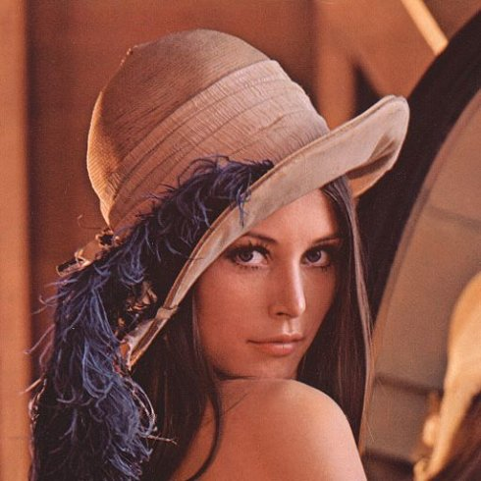
Data Augmentation
Origin
Horizontal Flip
Random Crop
Center Crop

